Slide 1

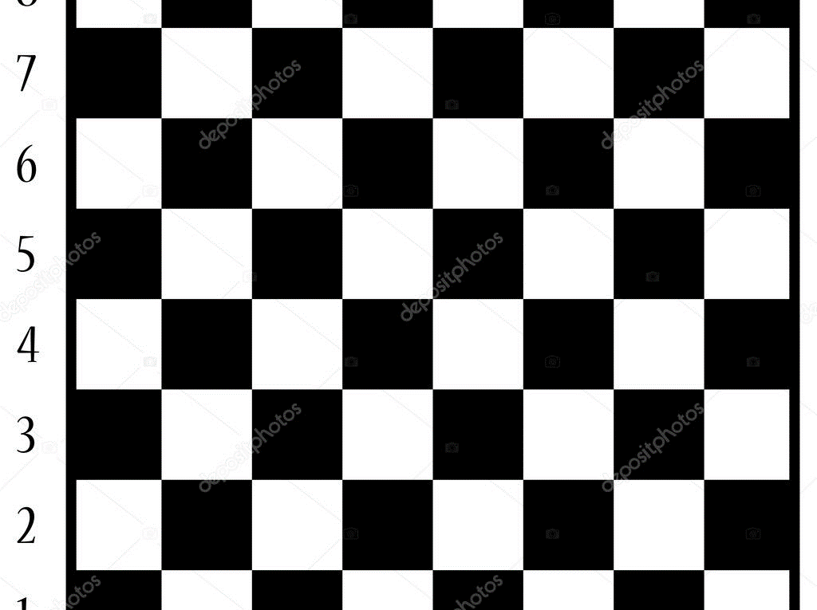
Top Tier Chess
Analysis of FIDE’s Top 100 Ranking Lists between July 2000 and November 2021

Slide 2
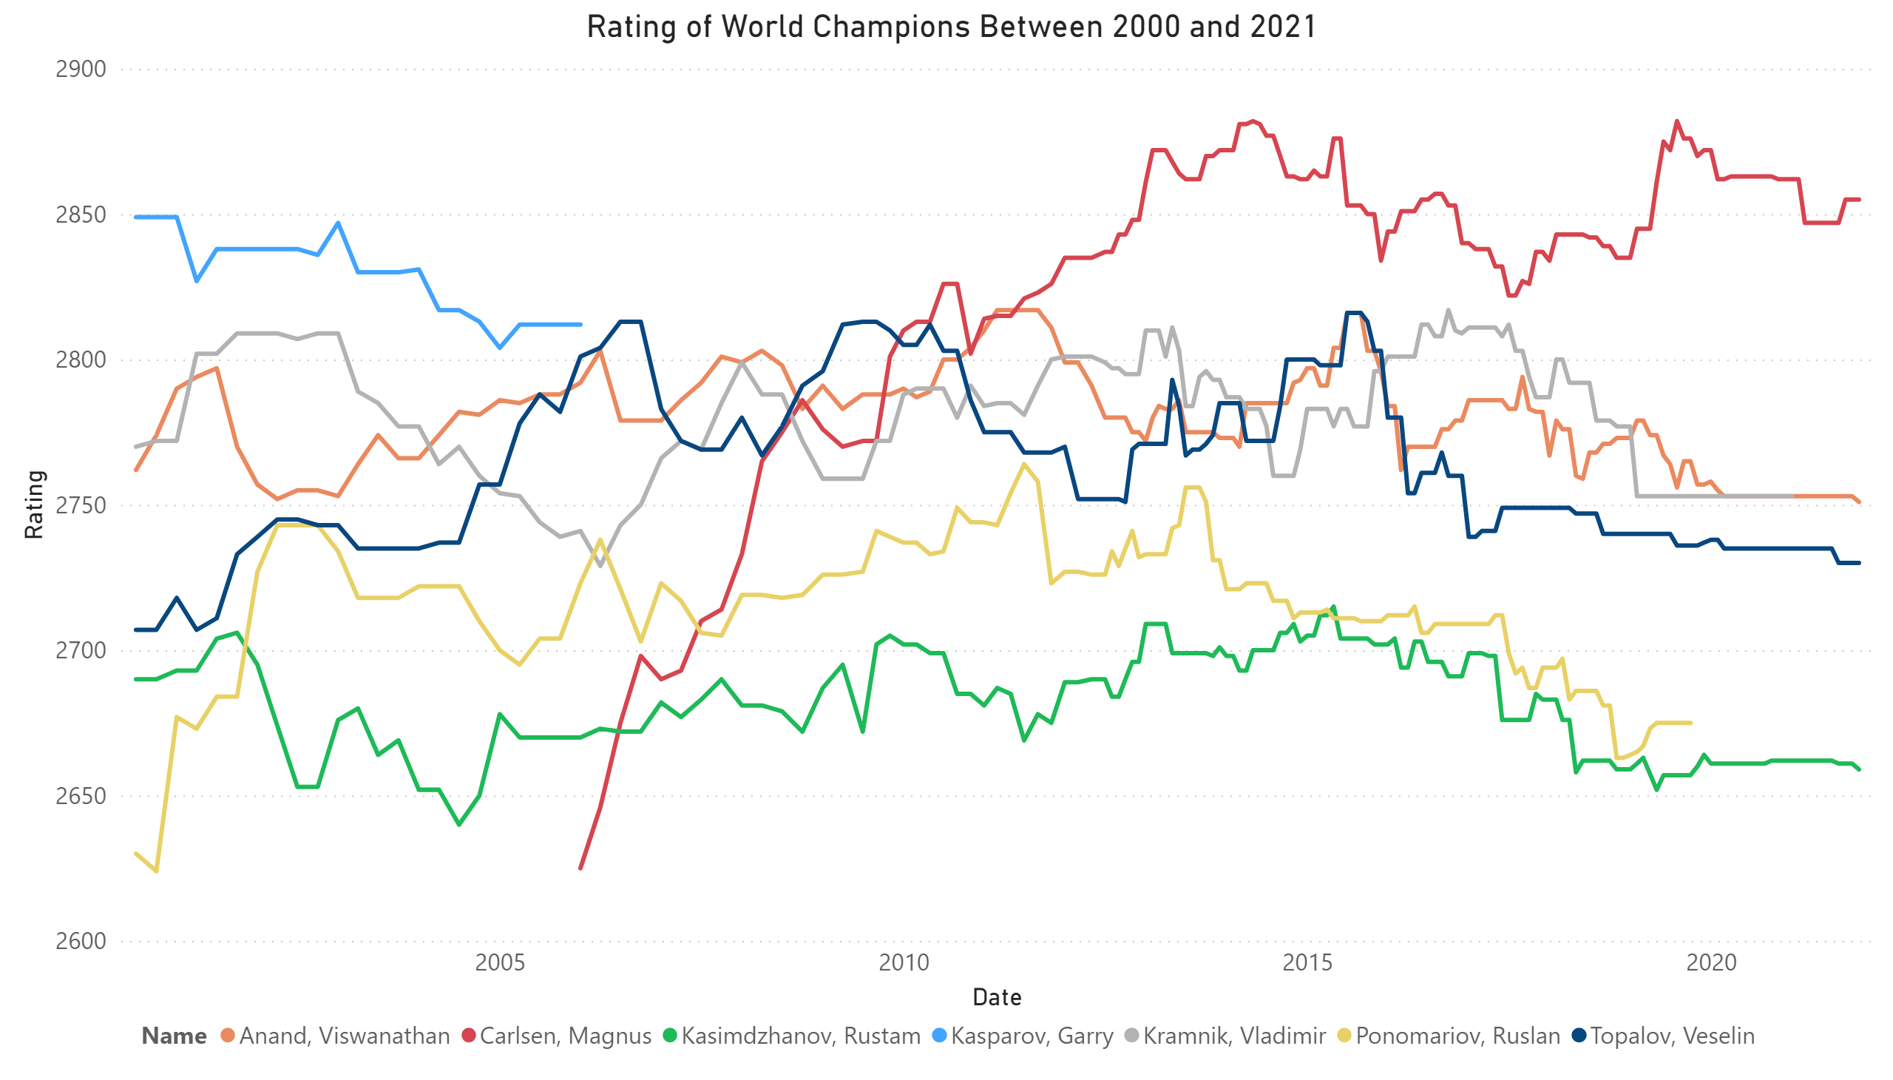
Paths of the World Champions
Since 2000, seven players have held the title of World Champion.
Five of those players have also held the #1 rank in the ratings list.
The two exceptions, Rustam Kasimdzhanov (peak ranking 11) and Ruslan Ponomariov (peak ranking 6) won their titles in knockout tournaments with short matches (best of eight for the championship).
These championships were heavily criticized for having too few games to reduce variability.
Neither Kasimdzhanov nor Ponomariov was successful in defending his title, and neither player challenged for the title again.

Slide 3
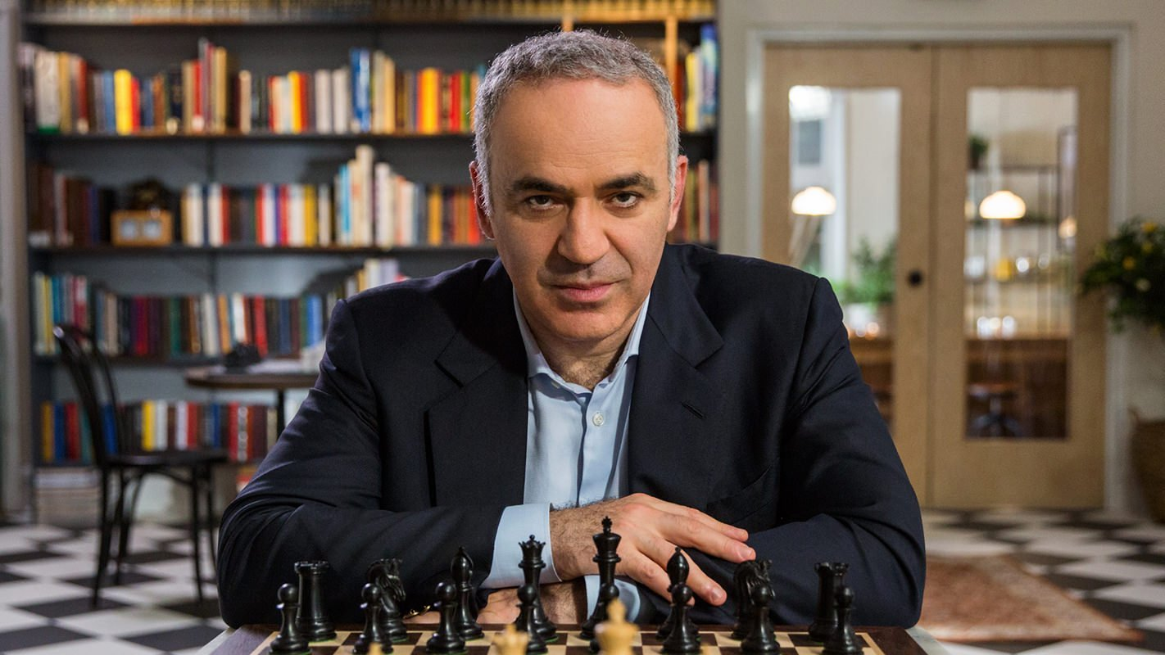
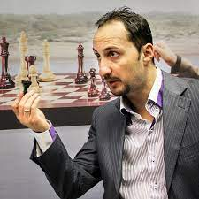
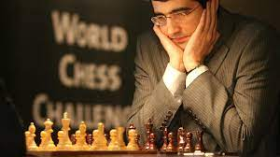
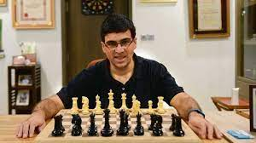

Rank 1 Players: An Introduction
Garry Kasparov
Veselin Topalov
Incredibly, only 5 players have held the rank 1 spot in chess over the past twenty-one years:
This fact is less surprising upon further examination:
All five players have held the World Champion title at some point.
Garry Kasparov (considered the most dominant player in modern history) held the top spot continuously from 1984 until his retirement in 2005, a record 255 months;
Magnus Carlsen, current and 5x world champion, has held the rank 1 spot continuously since July 2011.
An interesting question (and one constantly debated by chess commentators) is the relative dominance of each of these players.
Vladimir Kramnik
Viswanathan Anand
Magnus Carlsen

Slide 4
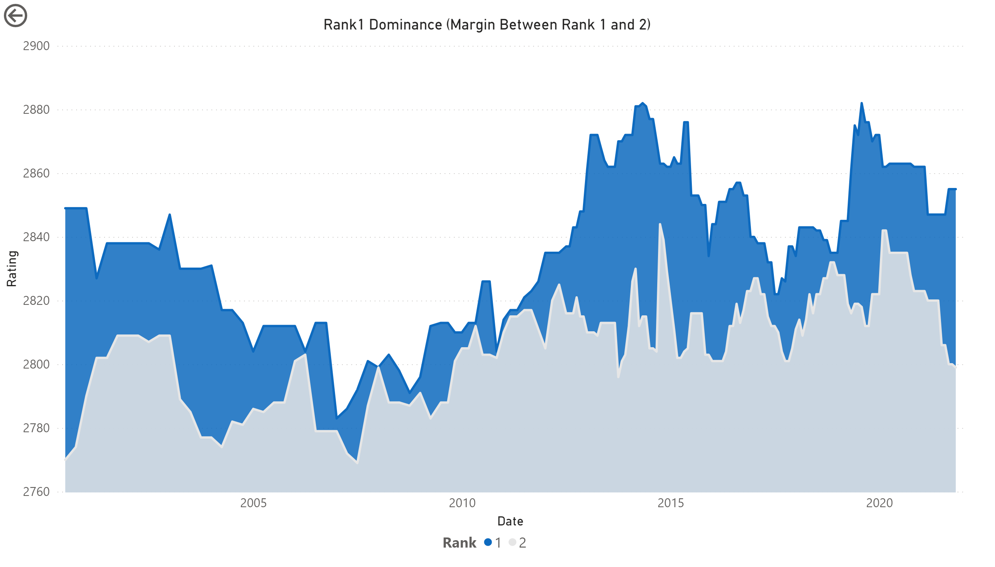
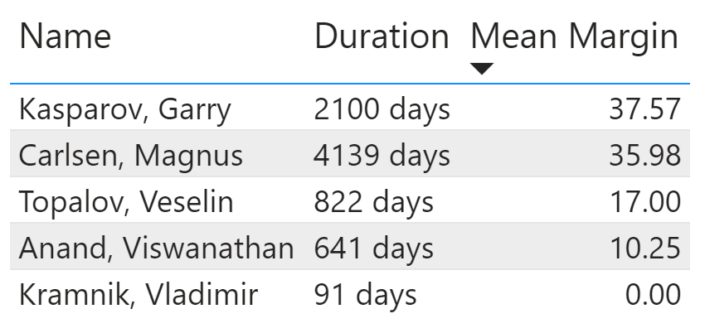
Relative Dominance: Duration and ELO Superiority
The dataset provided two means for determining the relative dominance of rank 1 players:
The duration each player held rank 1; and
The difference in ELO between the rank 1 player and the rank 2 player.
Unsurprisingly, both metrics point to Kasparov and Carlsen as exerting far more dominance than Anand, Kramnik and Topalov.
Somewhat surprisingly, Kasparov’s mean ELO superiority exceeds that of Carlsen, even though the data period only includes the tail-end of Kasparov’s career.
The dataset begins in July 2000. Garry Kasparov held the Rank 1 position from 1984 until his retirement in 2005, a record 255 months.
Notes:
Note how slim the margin becomes from 2005 to 2012 (i.e. the period between Kasparov’s retirement and Magnus Carlsen’s ascent to No. 1)

Slide 5
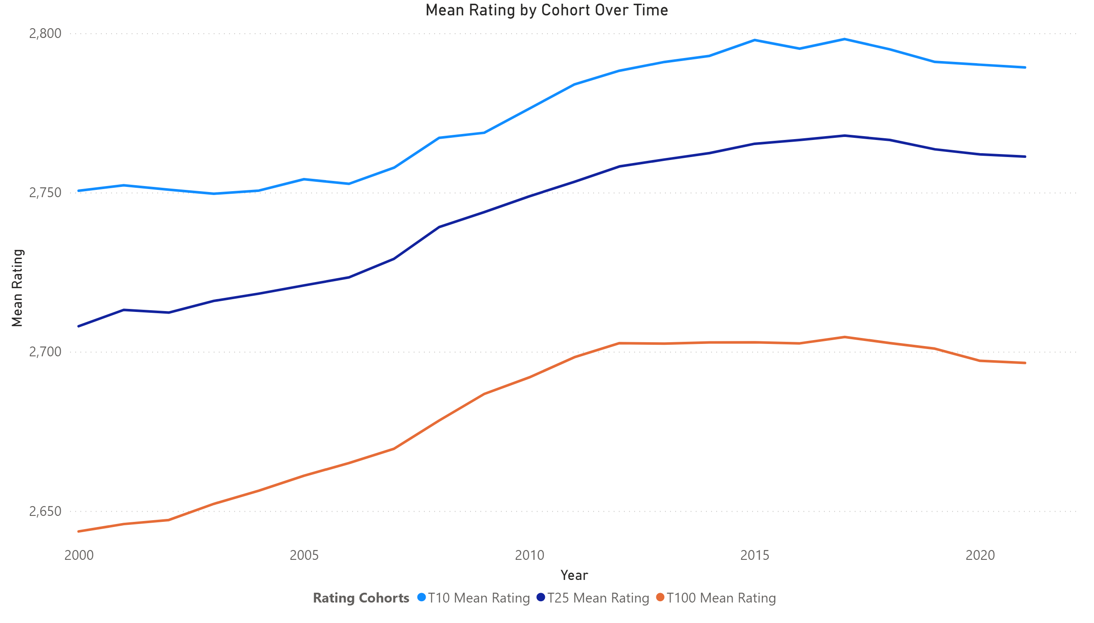
Analysis: Mean Ratings Does Rating Inflation Exist?
An interesting question long discussed in chess circles is whether ELO (ratings) are inflating over time.
As shown to the right, the last twenty-one years clearly provides some support for this hypothesis.
Interestingly, this increase in mean ELO hits plateaus across each rating cohort.
More interestingly, these plateaus begin at different times:
For the T100, mean ELO plateaued in 2012 (ELO 2702)
For the T25, mean ELO plateaued in 2017 (ELO 2767)
For the T10, mean ELO plateaued in 2015 (ELO 2797)
This leads to a few interesting alternative hypotheses…

Slide 6
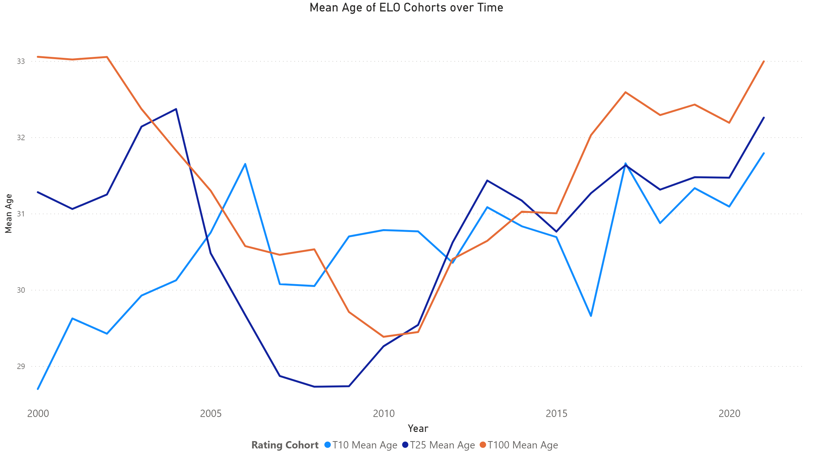
Analysis: Age of Top 100 Players Did a Young Cohort of Players Cause the Increase in Average ELO?
The dataset presents another possible explanation for the increase in mean ELO.
Namely the mean age of players in the Top 100 decreased from 33.06 to 29.45 between 2000 and 2011.
It seems possible that a young cohort rose in the ranks from 2005 to 2015, slowly pushing the median ELO upwards.
Tacked on to this hypothesis is the rise of computer-assisted training, which became increasingly prevalent in the 2000s.

Slide 7
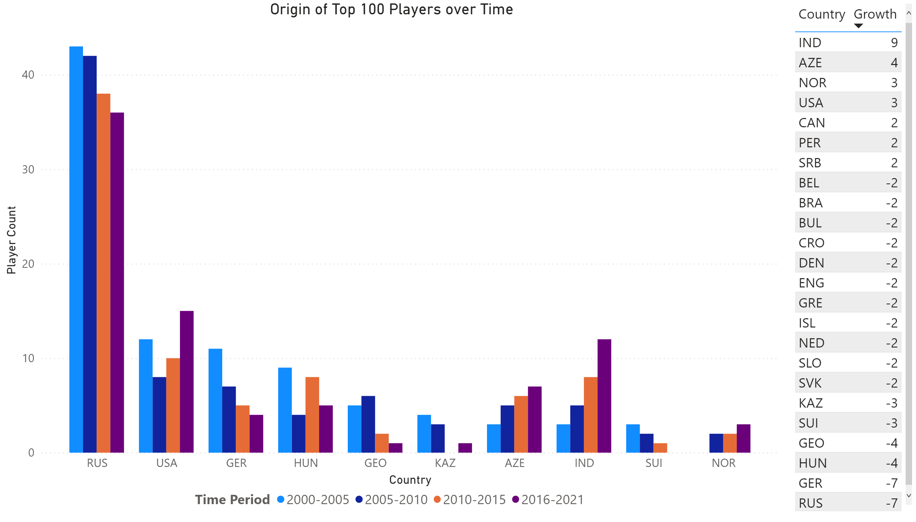
Country of Origin: A Changing Tapestry
Finally, the data lent itself to an examination of the country of origin of chess players over time.
The most notable changes were the slow decline of Russia and the rise of India as a chess powerhouse.

